Slide 1
Reproducible science: principles, practices and tools
School of Psychology and Vision Sciences

Slide 2
The team
Who are we and why we are doing this?
How to interact with the material: Try things out, talk to your group, ask instructors
Multimedia materials available here: github/…

Slide 3
Why are we doing this?
Who are we and why we are doing this?
How to interact with the material: Try things out, talk to your group, ask instructors
Multimedia materials available here: github/…

Slide 4
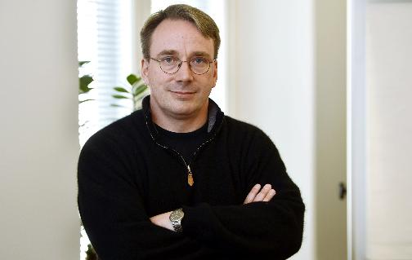
Workshop philosophy
Use the right tool for the job
Focus on practical advice
Level 1: What you need
Level 2 and more: Desirable but not essential
Linus Torvalds, 2018. Photograph by Kimmo Mäntylä / REX / Shutterstock

Slide 5
Plan
Day 1
Day 2
Day 3
R Primer
Reproducible methods: Intro
“New” statistics
Visualization
Pre-registration
“How-to”
Version Control
Power with R
Feedback
Notes:
More hands-on activities, e.g. around pre-registration
To discuss across college. Possible collaboration on common themes (e.g. version control)
Start as a modular masterclass, integrating materials accumulated by the team in the last 3 years
Ultimately compiled as book / online resource

Slide 6
Day 1: Using R for reproducible analyses and documenting your work

Slide 7
Setting up
Wi-Fi: eduroam or XXX?
Get the materials from the GitHub account / USB sticks around
Handout online & printed
Live-coding videos
Exercises with various levels of hints / scaffolding

Slide 8
Use of AI
AI can be very useful for small coding tasks.
It can still confabulate & erase its tracks.
There is value in trying it out yourself.
You’ll remember the lessons better.
Domain expertise x AI = XX

Slide 9
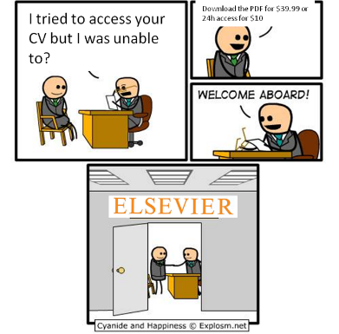
Open science
Open Access > No barriers to access research
Open Source > Using R / python
Open Materials > Open Educational Materials
Transparency > Pre-registration, preprints ...
Collaboration > Team Science
Open Peer Review, etc.
Notes:
"Open scholarship": broadly refers to a set of principles and practices that aim to increase the transparency, rigor, reproducibility, replicability, incrementalism and inclusivity of research"

Slide 10
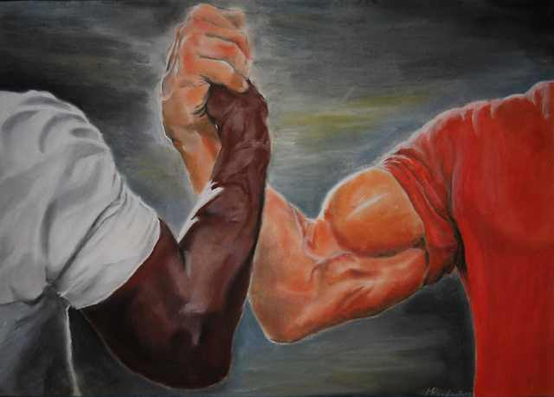
Open science & reproducibility
Reproducible science
Methodological rigor
Open Science values

Slide 11
How to work through exercises
Try by yourself first
Discussion with neighbours encouraged
If stuck:
Ask us
Have a glimpse at complete worksheets
Check the exercise times

Slide 12
Weird things happen

Slide 13
Live demo
Characteristics of R-Studio
Source vs Visual
…
Chunks…
Etc.

